Slide 1
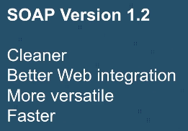
Difference between SOAP v1.1 and SOAP v1.2

Slide 2
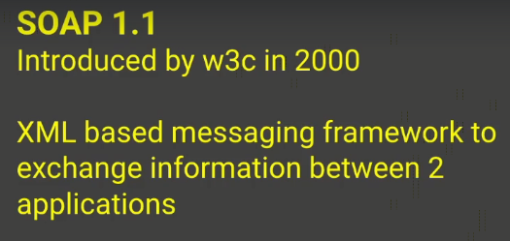
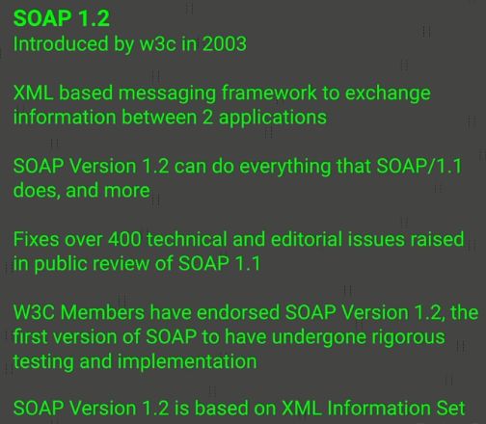
Difference between SOAP v1.1 and SOAP v1.2

Slide 3
What is a Web Service?
https://www.udemy.com/course/web-services-api-step-by-step-beginner-tutorial/learn/lecture/16638014#overview

